Slide 1
5G ARENA Mobile Selling Platform

Slide 2
About 5G ARENA
5G Arena, a website that allows customers to select the best mobiles they need and buy them in one place.
The new 5G technology has started to expand in all major cities, by using this website you can select the best 5G mobiles launched recently.

Slide 3
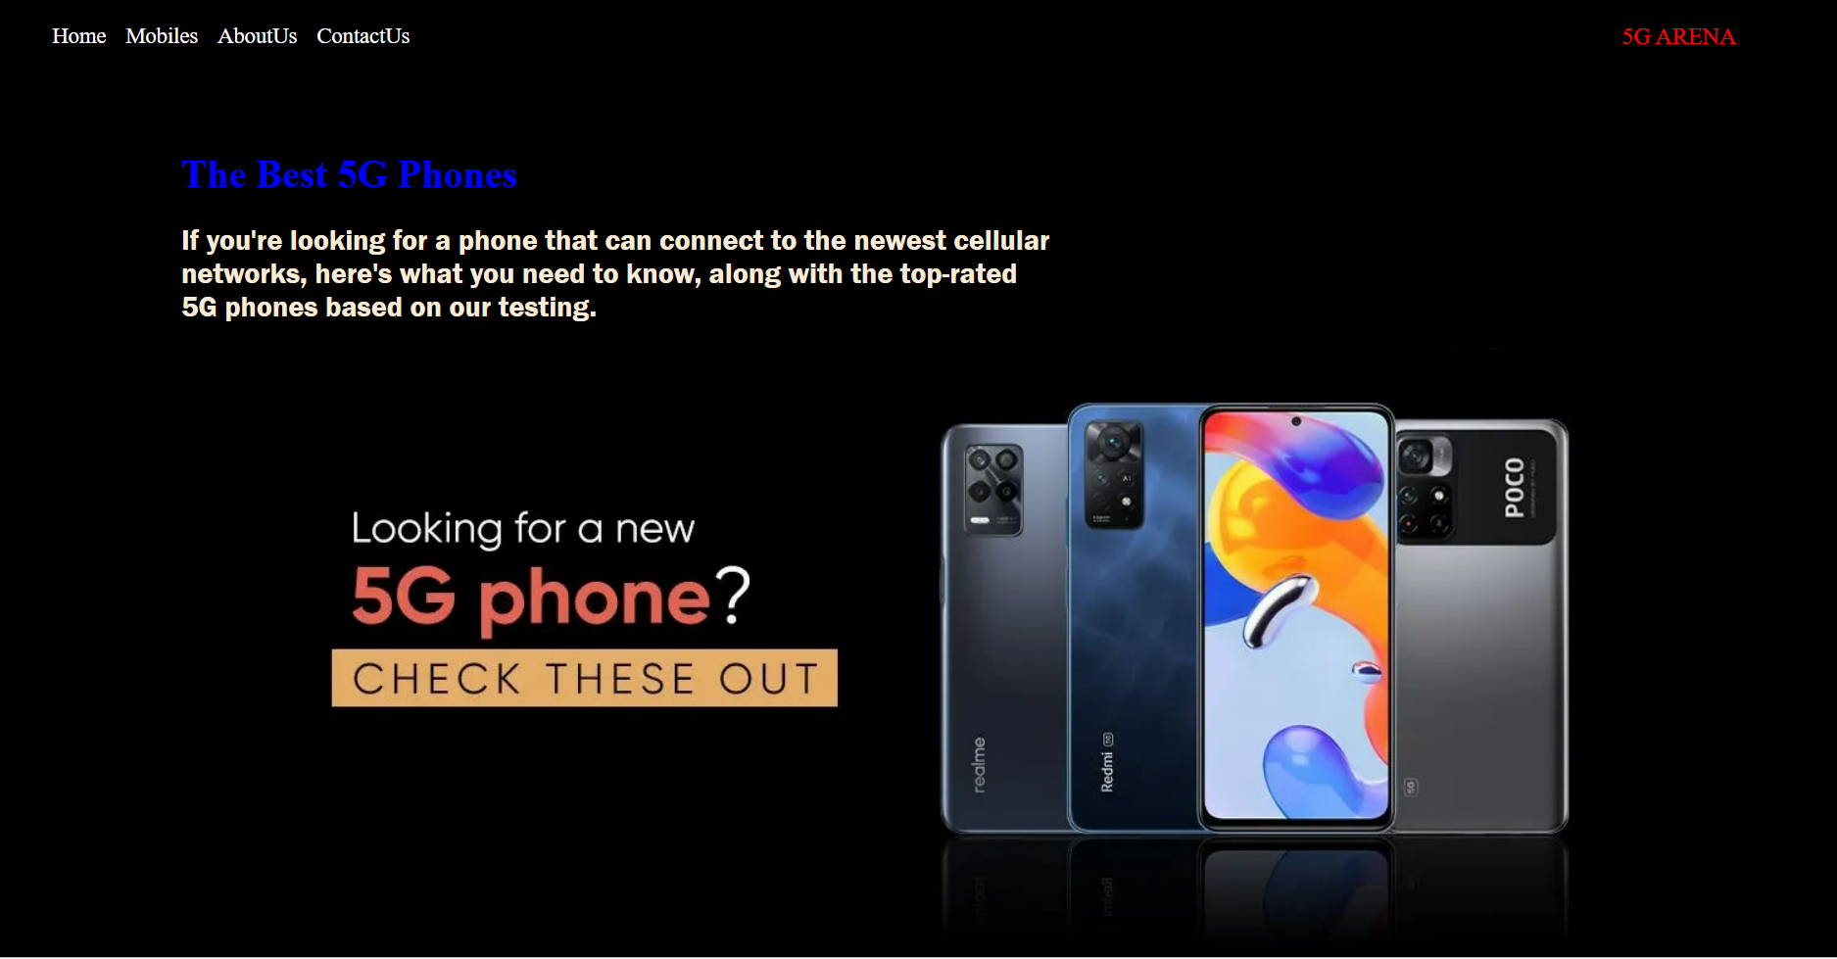
Home page
By using this page user’s can redirect to other page by selecting the respective link
From the home page you can access all the pages of the website
From here.

Slide 4
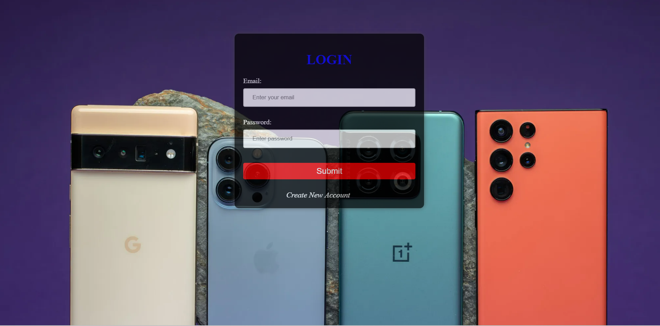
Login page
If you are a existing user you can use USERNAME & PASSWORD.
Otherwise you need to create a new account.
The user need to SIGN-IN in order to use the website

Slide 5
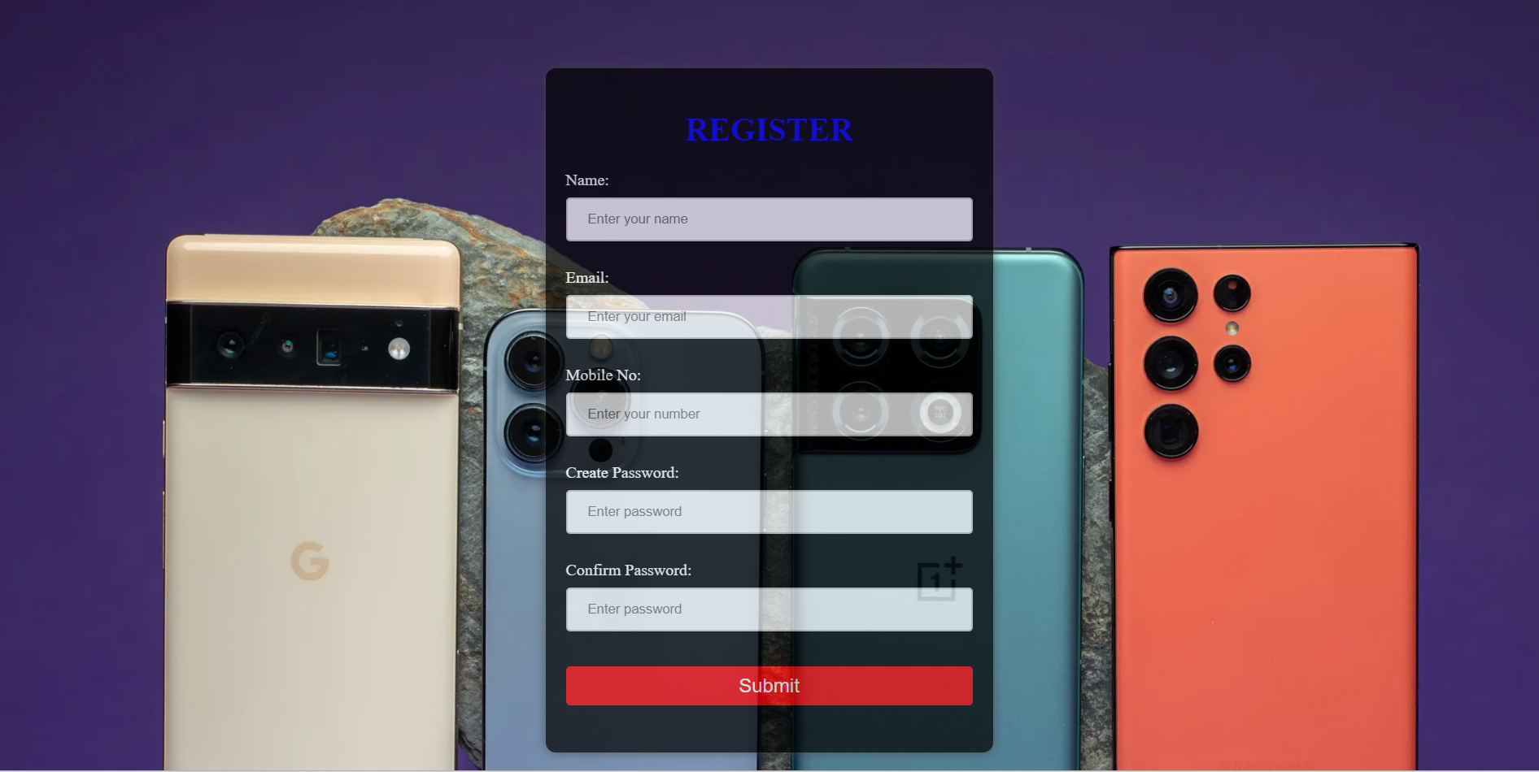
Sign-up Page
If a user doesn’t have an account in this website, The user can create a new account in this page.
In this page user must fill the provided details in the site. This inputs are validated.

Slide 6
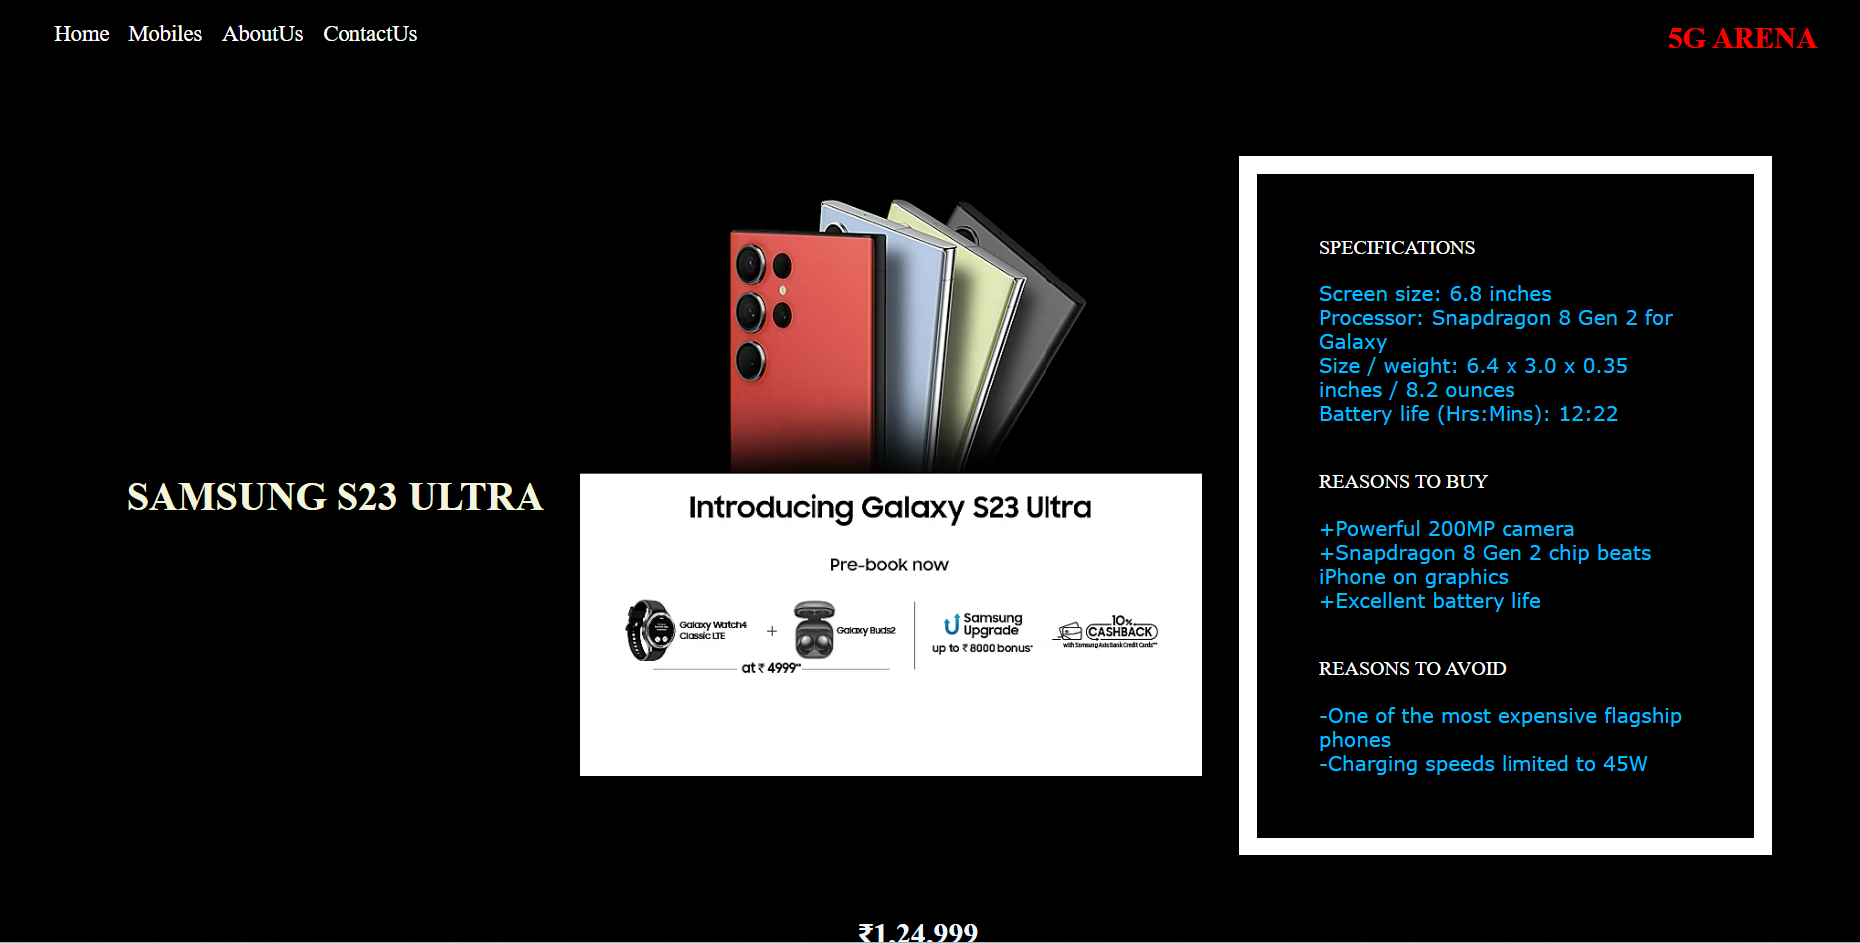
Mobiles Page
In this page user can view
The mobiles available in the market.
Users can also get the details of the mobile.

Slide 7
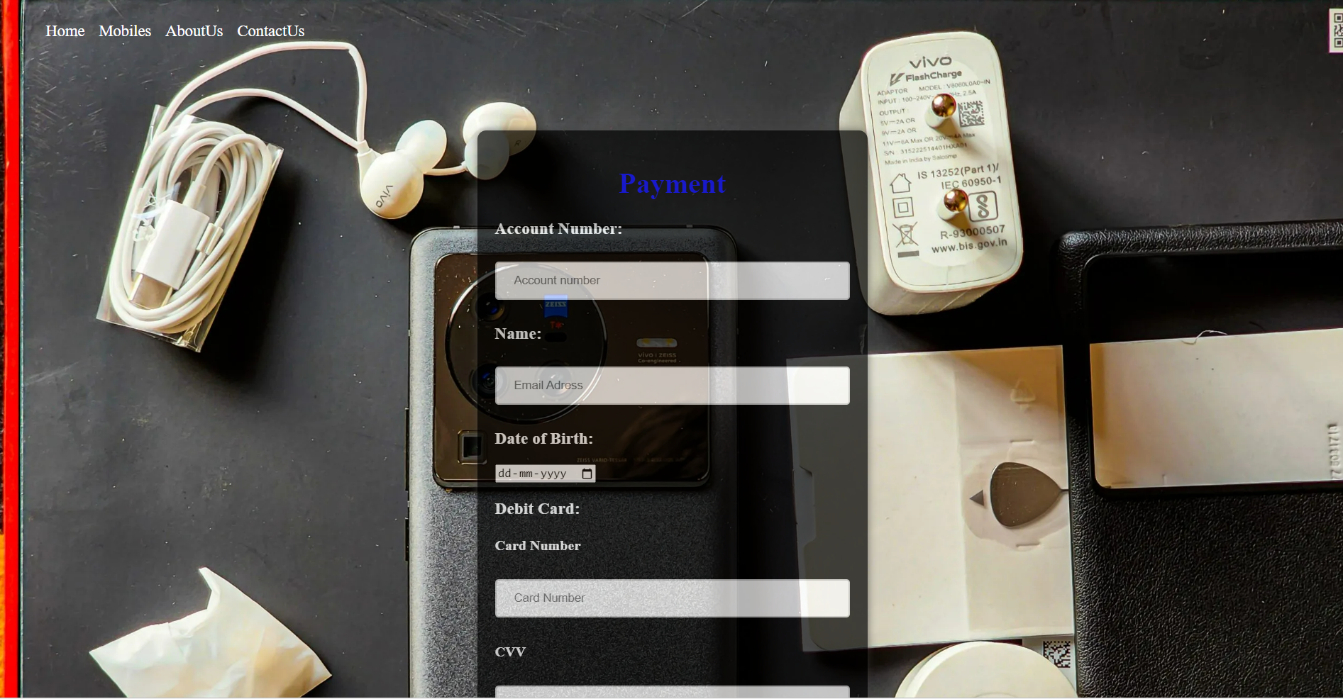
Payment Page
In this page , users can pay the amount online by entering their details.

Slide 8
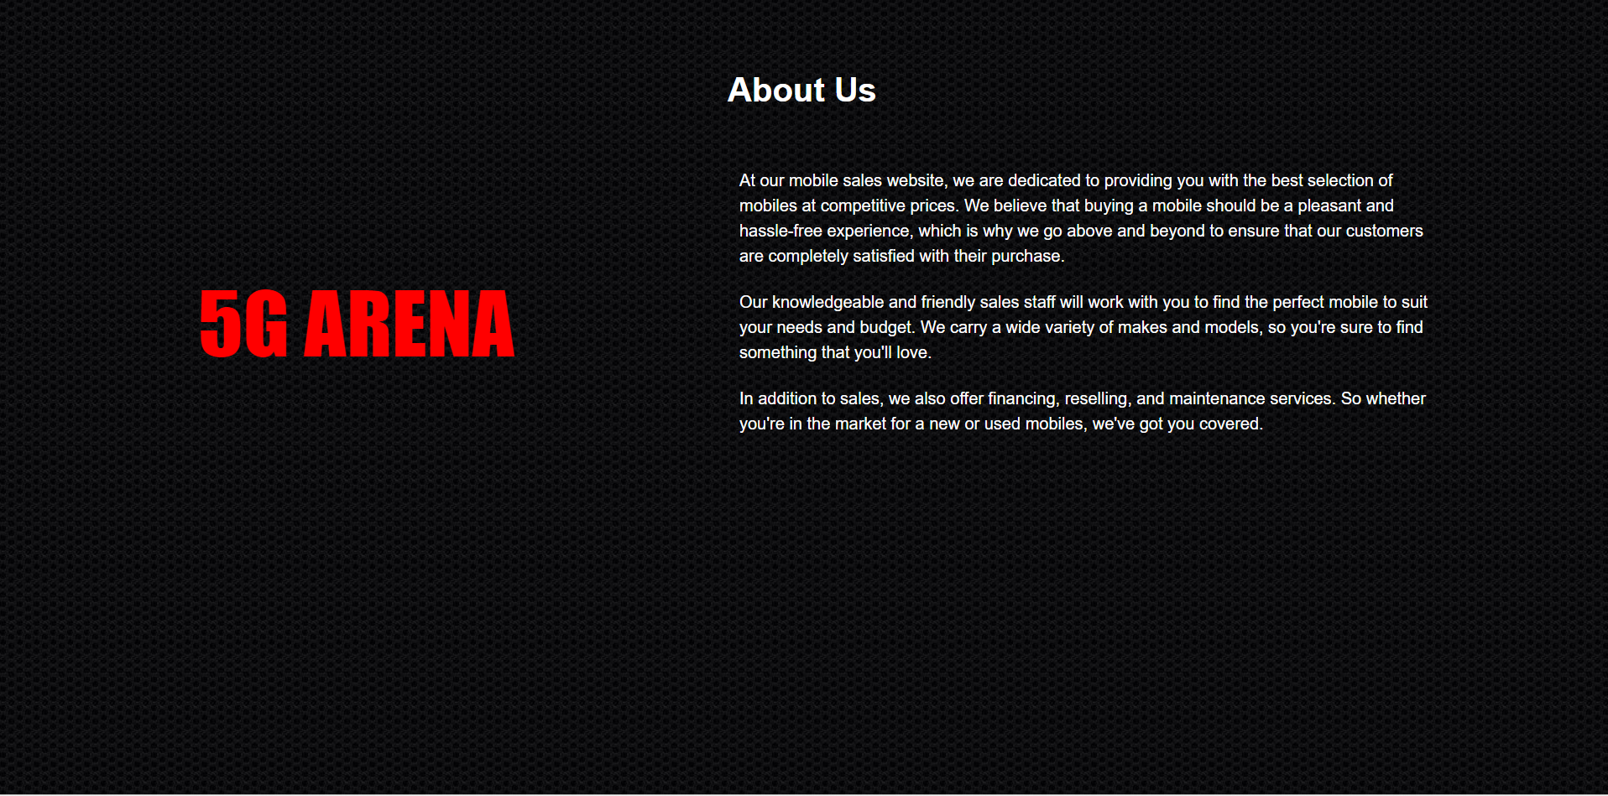
About Us Page
In this page user can get our contact details. And user’s can know about our website here.

Slide 9
5G ARENA
THANK YOU

